Slide 1
Complex Event Processing for Internet of Things
[IHDCB339] Introduction to the scientific process
Presented by Kenny Warszawski
Promotors Moussa Amrani
Pierre-Yves Schobbens

Slide 2
Contents
Introduction
Complex Event Processing
Computing Levels
Problematisation
Conclusion
Questions

Slide 3
Introduction

Slide 4
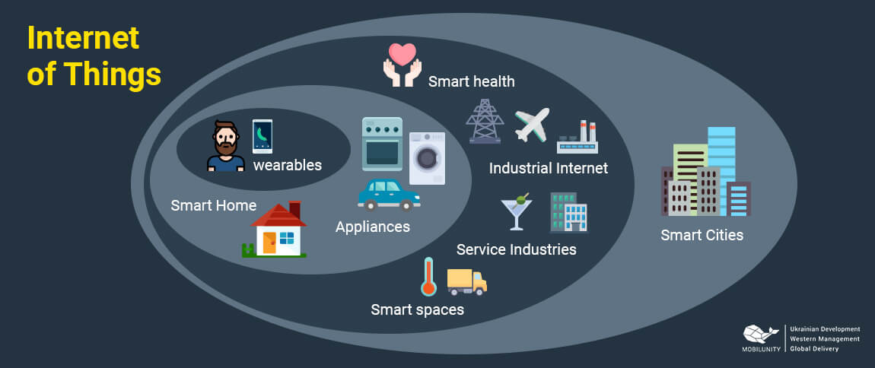
Introduction
“System of interrelated computing devices, mechanical and digital machines, objects, animals or people that are provided with unique identifiers (UIDs) and the ability to transfer data over a network without requiring human-to-human or human-to-computer interaction.”

Slide 5
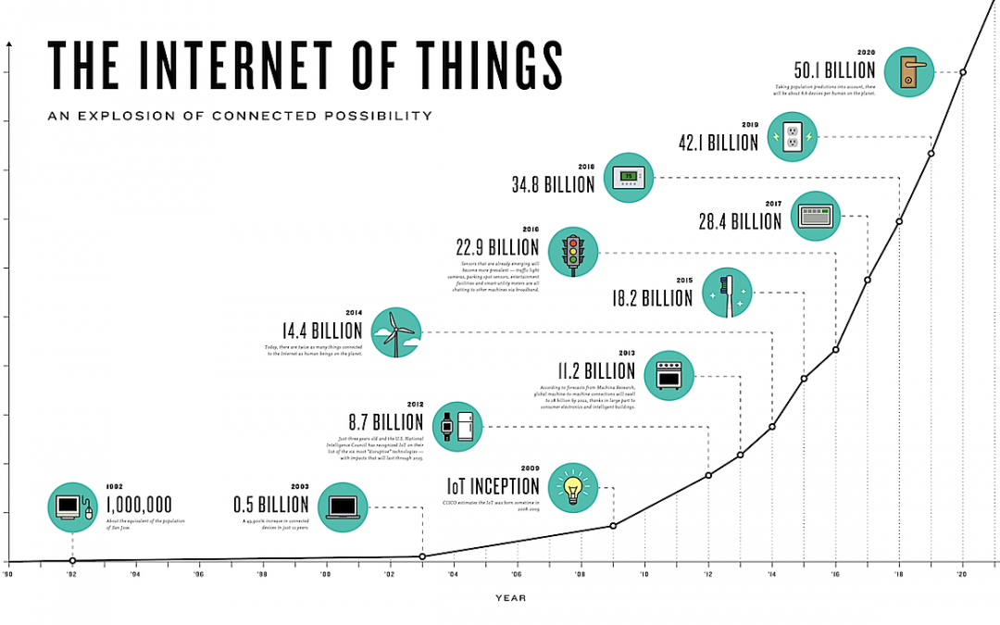
Introduction

Slide 6
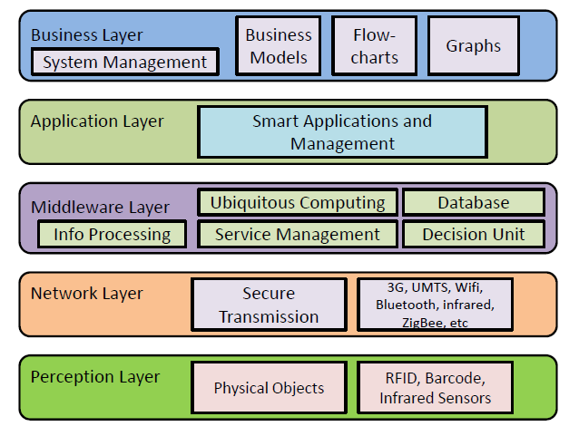
Introduction
Generic Architecture :

Slide 7
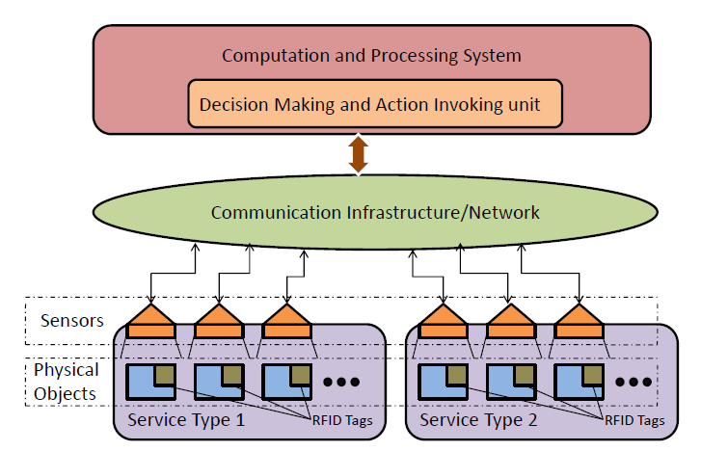
Introduction

Slide 8
Complex Event Processing

Slide 9
Complex Event Processing
Definition : ”[…] Set of methods and techniques for tracking and analyzing real-time streams of informations and detecting patterns or correlations of unrelated data (complex events) that are of interest to a particular business.”
Important : Event Correlation

Slide 10
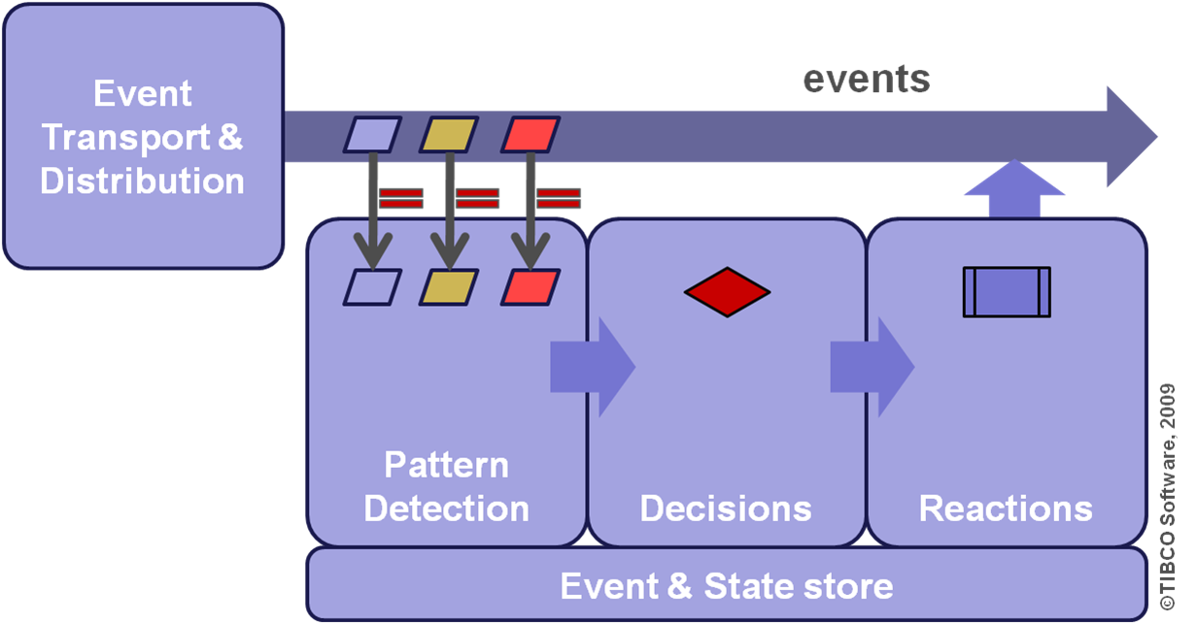
Complex Event Processing
CEP Engine :

Slide 11
Complex Event Processing
Event Pattern Language : ”An Event Pattern Language (EPL) is a language used by CEP engines in order to describe the relations between events (Event Correlation) matching a specific pattern.”
Operators :
Selection
Projection => Extraction of attributes
Window
Conjunction => ‘AND’
Disjunction => ‘OR’
Sequence => Ordering
Repetition
Aggregation => Specific operation on attributes (e.g: average)
Negation => ‘NOT’

Slide 12
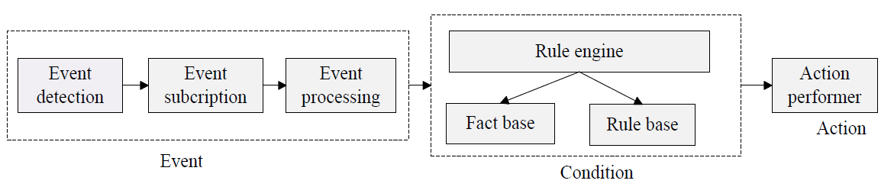
Complex Event Processing
Event Condition Action Pattern :

Slide 13
Computing Levels

Slide 14
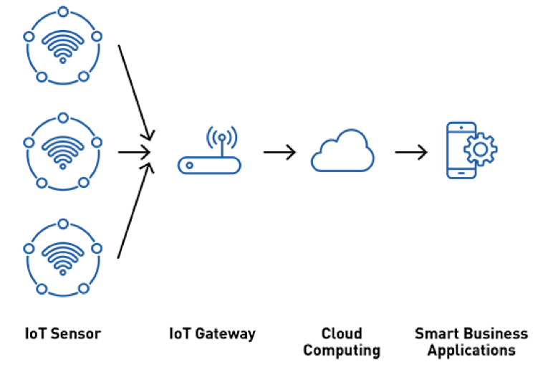
Computing Levels
Cloud Computing: ”[…] On-demand availability of computer system resources, especially data storage and computing power, without direct active management by the user.”

Slide 15
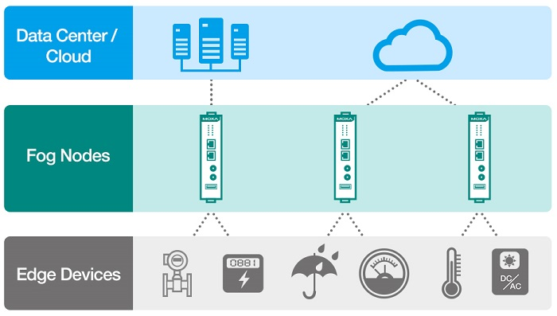
Computing Levels
Fog Computing: ”Both cloud computing and fog computing provide storage, applications, and data to end-users. However, fog computing has a closer proximity to end-users and bigger geographical distribution..”

Slide 16
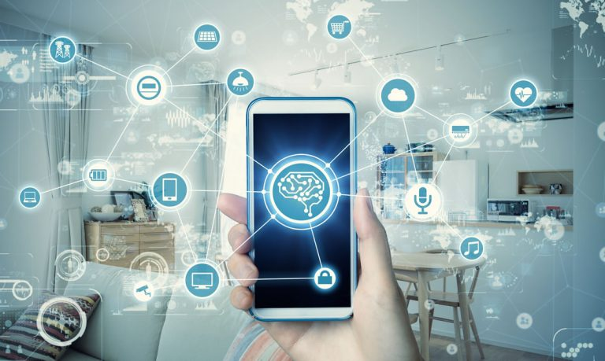
Computing Levels
Edge Computing: ”[…] Distributed computing paradigm which brings computation and data storage closer to the location where it is needed, to improve response times and save bandwidth.”

Slide 17
Problematisation

Slide 18
Problematisation
”Which Internet of Things architecture is adapted for an evolving solution where the connected objects are growing day by day ? ”
Aspects:
Scalability
Reliability
Monitorability
Extensibility

Slide 19
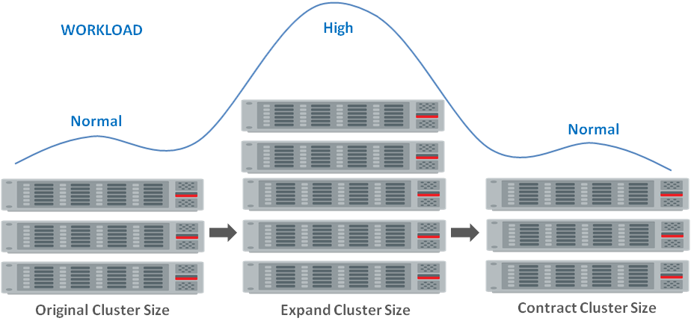
Problematisation
Scalability :
Hardware scalability

Slide 20
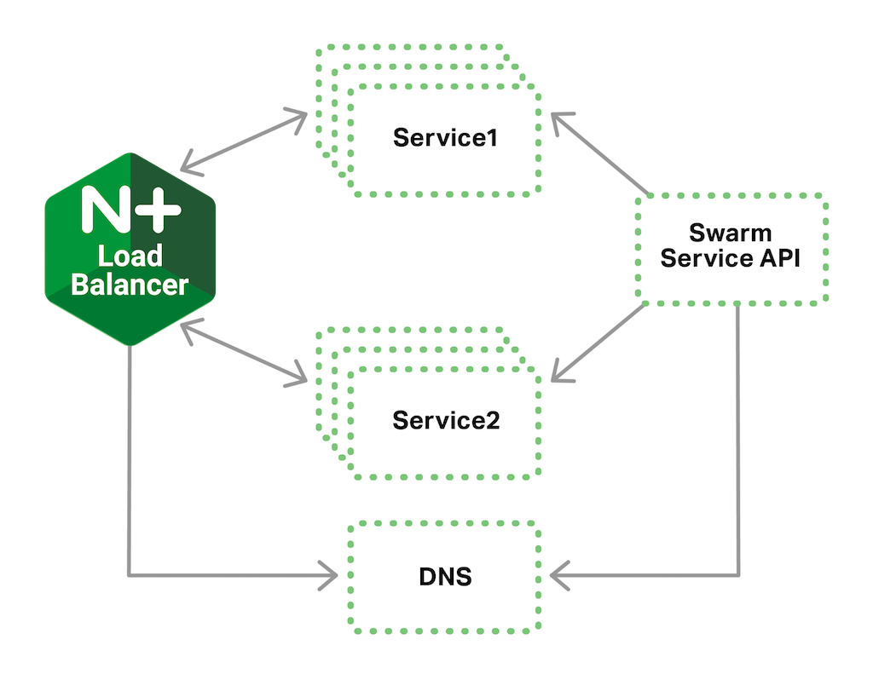
Problematisation
Scalability :
Software scalability

Slide 21
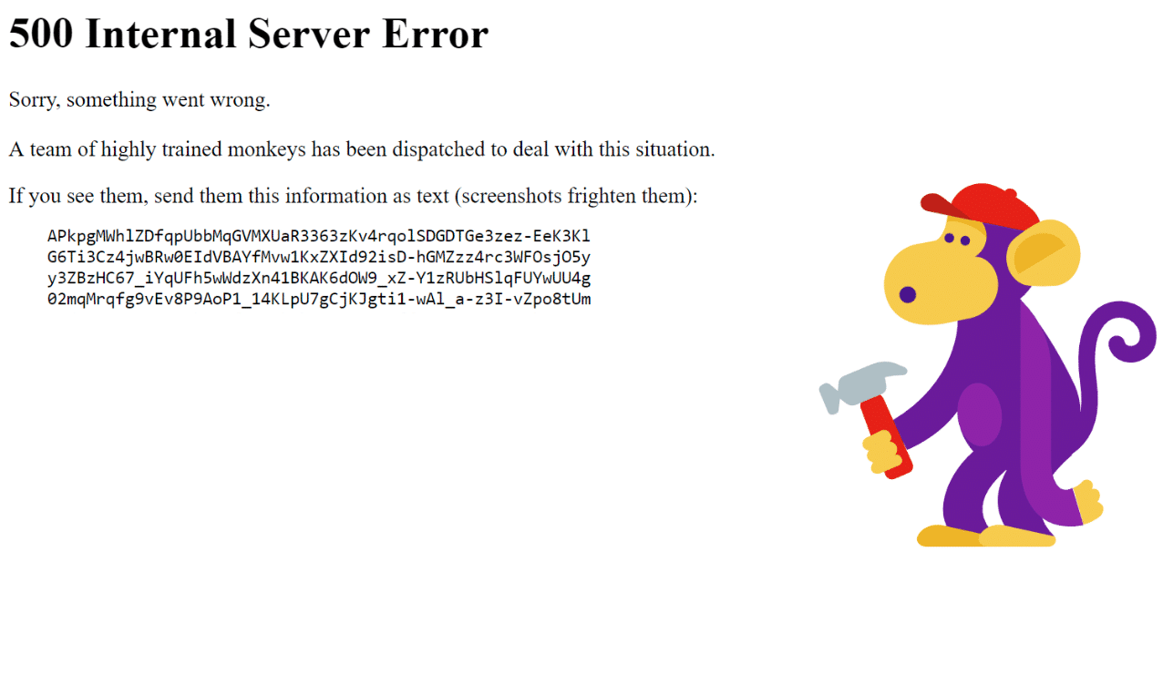
Problematisation
Reliability : ”An IoT solution should be fault tolerant and as much the hardware and the applications must me robust.”

Slide 22
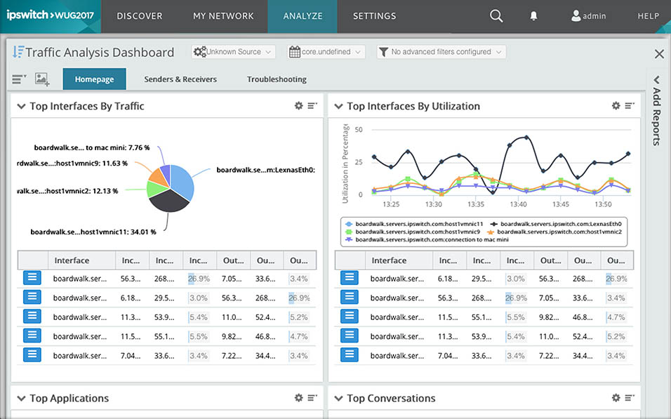
Problematisation
Monitorability :

Slide 23
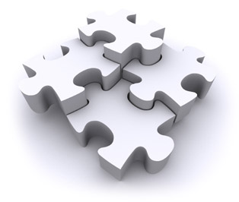
Problematisation
Extensibility :

Slide 24
Conclusion

Slide 25
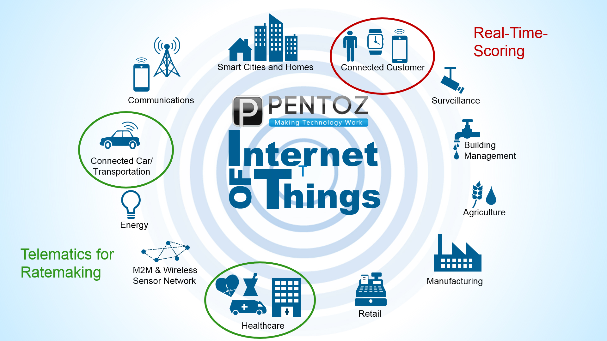
Conclusion

Slide 26
Questions

Slide 27

Questions

